Slide 1

Project Release Plan
Thingder 1/12/2016
Development Team:
Juan D. Cardozo
Yukio Rivera
Joseph Campuzano
Elizabeth Cepernich
Andrew De Neve
Andy Wong

Slide 2
Project Release Plan
Thingder
A bartering service that will connect people that want to trade objects. The service will use a ratings system that will take into account several factors when matching people to trade to find the best fit.

Slide 3
Project Release Plan –User Stories
Thingder Sprint 1: User stories
I want a login page + profile
I want to be able to post items
I want a simple user-interface
I want to be able to specify category/condition/price range of items

Slide 4
Project Release Plan –User Stories
Thingder Sprint 2: User stories
I want a GUI for a simple rating system
I want to be able to match trades with other people
I want to be able to match with locals

Slide 5
Project Release Plan –User Stories
Thingder Sprint 3: User stories
I want to be able to buy/sell items
I want to be able to pay online
I want to be able to negotiate in direct messages on the site
I want to be able to sort items by user rating
I want to get Email notifications about matches

Slide 6
Project Release Plan – Challenges/Risks
Thingder
Challenges:
Learn web2py, API’s and python.
Variable schedules of team members
Unfamiliarity with SCRUM and agile development

Slide 7

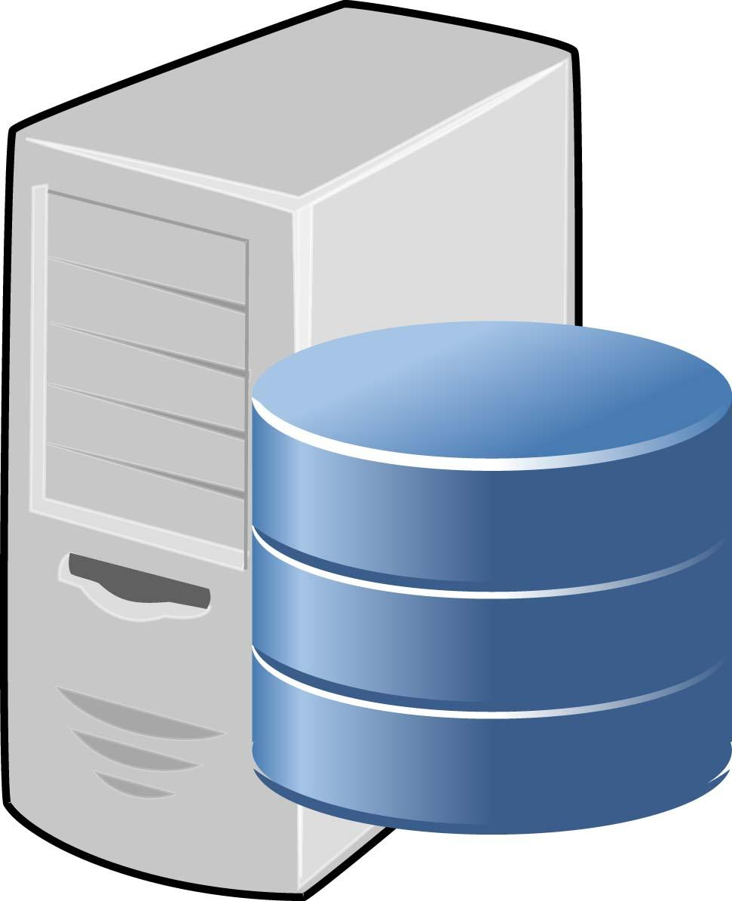
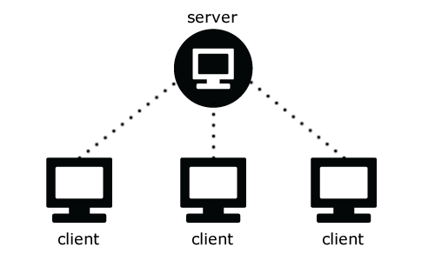

Project Release Plan – Architecture
Thingder System layout

